Slide 1

Chapter 3: the enhanced e-r model
Modern Database Management

Slide 2
Objectives
Understand use of supertype/subtype relationships
Understand use of specialization and generalization techniques
Specify completeness and disjointness constraints
Develop supertype/subtype hierarchies for realistic business situations
Explain universal (packaged) data model
Describe special features of data modeling project using packaged data model

Slide 3
EER: Supertypes and Subtypes
Enhanced ER model: extends original ER model with new modeling constructs
Supertype: A generic entity type that has a relationship with one or more subtypes
Subtype: A subgrouping of the entities in an entity type that has attributes or relationships distinct from those in other subgroupings

Slide 4
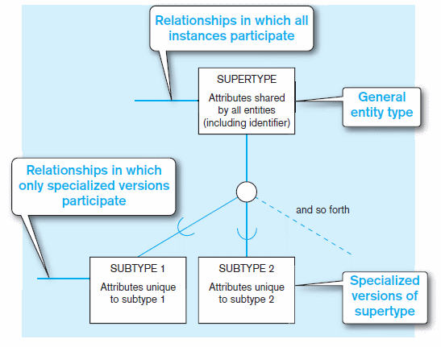
Basic notation for supertype/subtype notation

Slide 5
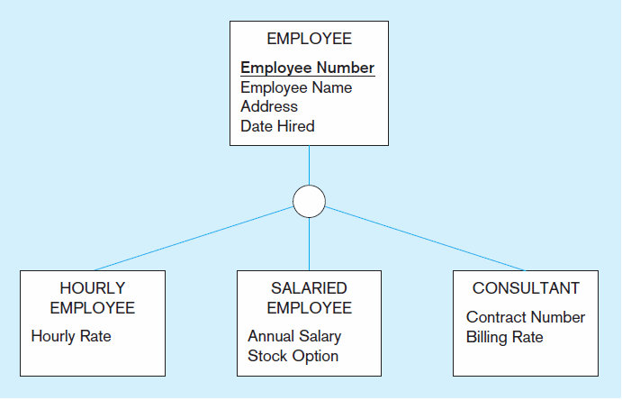
Example: Employee supertype with three subtypes
All employee subtypes will have employee number, name, address, and date hired
Each employee subtype will also have its own attributes

Slide 6
How attributes of a supertype relate to its subtypes?
Attribute Inheritance
Subtype entities inherit values of all attributes of the supertype
An instance of a subtype is also an instance of the supertype
Can we say the opposite?
Supertype entity inherits values of all attributes of the subtype ???
An instance of a supertype is also an instance of the subtype ???

Slide 7
How relationships of a supertype relate to its subtypes?
Subtype entities inherit all the relationships of the supertype (e.g. all subtypes will participate in the relationships of their supertype)
The instances of a subtype may participate in a relationship unique to that subtype.

Slide 8
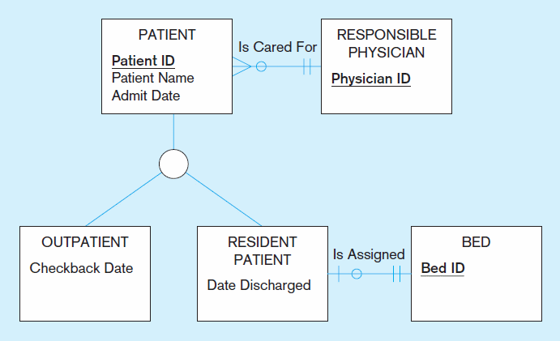
When to Use Supertype/Subtype Relationships?
(1) There are attributes that apply to some (not all) instances of an entity type.
(2) The instances of a subtype participate in a relationship unique to that subtype.

Slide 9
Relationships Between a Supertype and Its Subtypes (Summary)
Attributes
Attribute Inheritance
Subtype entities inherit values of all attributes of the supertype
An instance of a subtype is also an instance of the supertype
The instances of a subtype have attributes that are unique to that subtype.
Relationships
Subtype entities inherit all the relationships of the supertype (e.g. all subtypes will participate in the relationships of their supertype)
The instances of a subtype may participate in a relationship unique to that subtype.

Slide 10
How to Define Supertype and Subtype?
Generalization: BOTTOM-UP
The process of defining a more general entity type from a set of more specialized entity types.
Specialization: TOP-DOWN
The process of defining one or more subtypes of the supertype and forming supertype/subtype relationships.

Slide 11
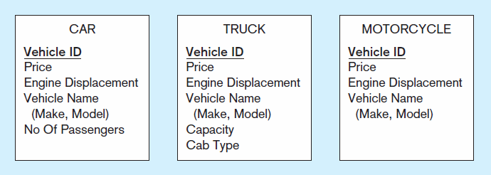
Figure 3-4: An Example of Generalization
a) Three entity types: CAR, TRUCK, and MOTORCYCLE
All these types of vehicles have common attributes

Slide 12
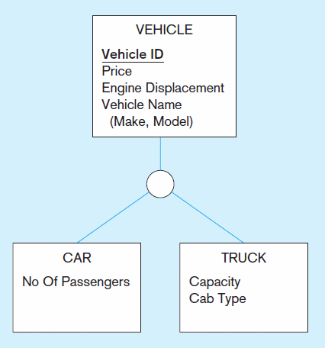
Figure 3-4: An Example of Generalization (cont.)
b) Generalization to VEHICLE supertype
So we put the shared attributes in a supertype
Note: no subtype for motorcycle, since it has no unique attributes

Slide 13
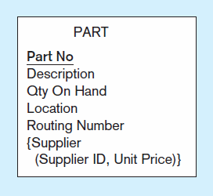
Figure 3-5: An Example of Specialization
a) Entity type PART
Apply to both manufactured parts and purchased parts (required attributes)
Only apply to manufactured parts (optional attribute)
Only apply to purchased parts (optional attribute)

Slide 14
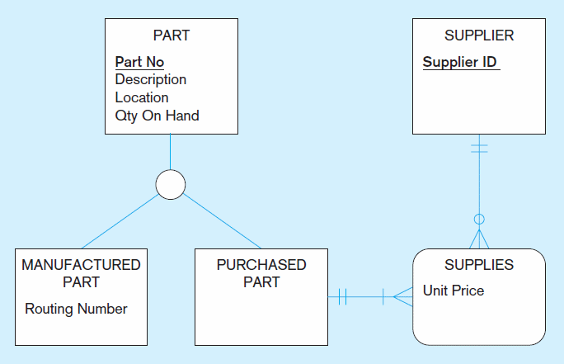
Figure 3-5: An Example of Specialization (cont.)
b) Specialization to MANUFACTURED PART and PURCHASED PART
Created 2 subtypes
Note: multivalued attribute was replaced by an associative entity relationship to another entity

Slide 15
Constraints in Supertype/Subtype: Completeness Constraints and Notations
Completeness Constraints: Whether an instance of a supertype must also be a member of at least one subtype
Total Specialization Rule: Yes (double line)
Partial Specialization Rule: No (single line)

Slide 16
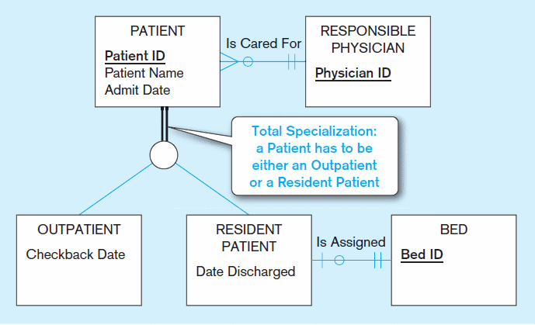
Figure 3-6: Examples of Completeness Constraints
a) Total specialization rule

Slide 17
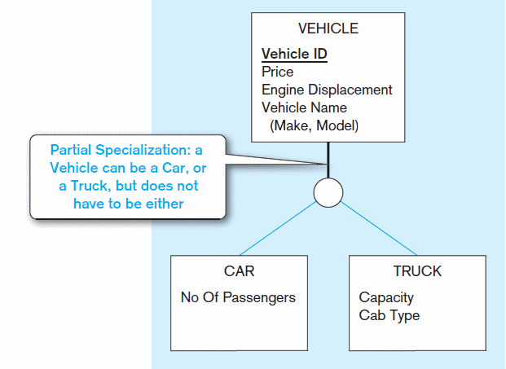
Figure 3-6: Examples of Completeness Constraints (cont.)
b) Partial specialization rule

Slide 18
Constraints in Supertype/Subtype: Disjointness Constraints and Notations
Disjointness Constraints: Whether an instance of a supertype may simultaneously be a member of two (or more) subtypes
Disjoint Rule: An instance of the supertype can be only ONE of the subtypes
Overlap Rule: An instance of the supertype could be more than one of the subtypes

Slide 19
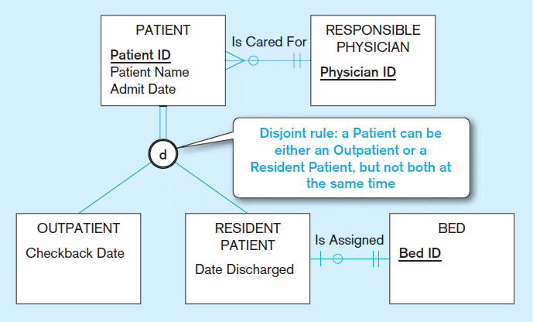
Figure 3-7: Examples of Disjointness Constraints
a) Disjoint rule

Slide 20
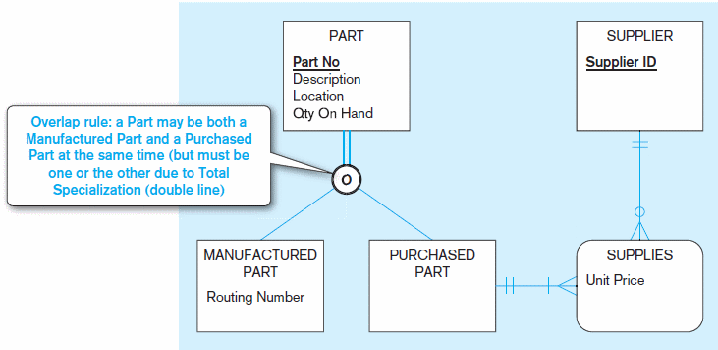
Figure 3-7: Examples of Disjointness Constraints (cont.)
b) Overlap rule

Slide 21
Constraints in Supertype/Subtype: Subtype Discriminators and Notations
Subtype Discriminator: An attribute of the supertype whose values determine the target subtype(s)
Disjoint – a simple attribute with alternative values to indicate the possible subtypes
Overlapping – a composite attribute whose subparts pertain to different subtypes. Each subpart contains a Boolean value to indicate whether or not the instance belongs to the associated subtype

Slide 22
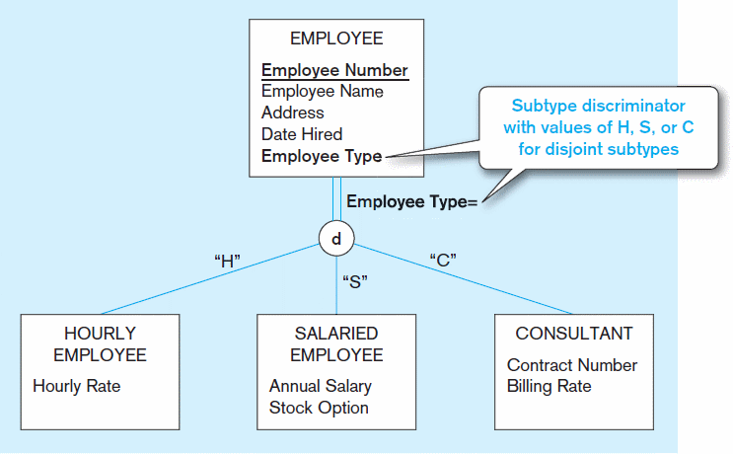
Figure 3-8: Subtype Discriminator (Disjoint Rule)

Slide 23
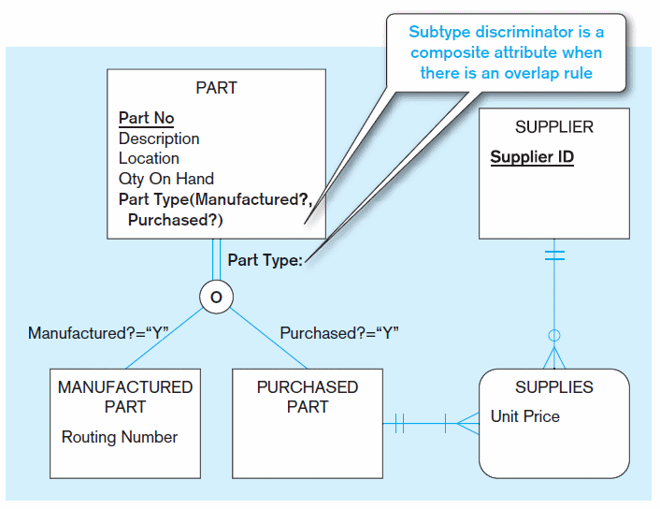
Figure 3-9: Subtype Discriminator (Overlap Rule)

Slide 24
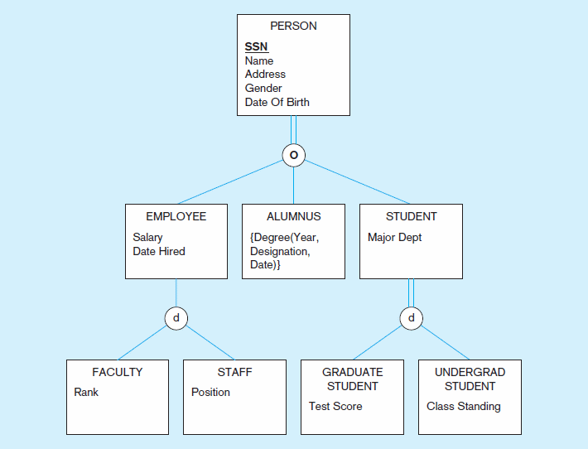
Figure 3-10: Example of Supertype/Subtype Hierarchy
Supertype/Subtype Hierarchy: A hierarchical arrangement of supertypes and subtypes in which each subtype has only one supertype.

Slide 25
Packaged Data Models
Predefined data models
Assuming that the underlying structures or patterns of enterprises in the same industry or function area is the same
Could be universal or industry-specific
Universal data model: a generic or template data model that can be reused as a starting point for a data modeling project (also called a “pattern”)
Customization is needed.

Slide 26
Advantages of Packaged Data Models
Use proven model components
Save time and cost
Less likelihood of data model errors
Easier to evolve and modify over time
Aid in requirements determination
Easier to read
Supertype/subtype hierarchies promote reuse
Many-to-many relationships enhance model flexibility
Vendor-supplied data model fosters integration with vendor’s applications
Universal models support inter-organizational systems

Slide 27
Data Modeling Process with Prepackaged Data Models
Prototyping is a typical method used for this type of projects.
The project would begin by identifying the parts of the packaged data model that apply to your specific project’s data modeling situation, rather than beginning to draw model elements.
The identified data elements from the packaged data model would be renamed to terms local to the organization.
Data in the packaged data model would be mapped to data in current organization databases, with the intent of developing migration plans for converting organizational data.

